Slide 1
CANADA REFUGEE STATISTICS FROM 2012-2016 ANALYZED WITH PYTHON BY MUDASHIRU HABEEB.

Slide 2
Analysis Questions
From which countries has Canada admitted the highest number of refugees?
What are the total number of resettled refugees in Canada per year?
What are the countries of origin for the majority of asylum claims made in Canada?
What is the total number of asylum claims made in Canada every year?
What are the general trends in refugee and asylum statistics from 2012-2022?

Slide 3
Description Summary :
The data was collected over the course of 10 years(2012 - 2022).
In the course of this period, we have an average of 752 refugees .
In the course of this period, we have an average of 323 assylum seekers.

Slide 4
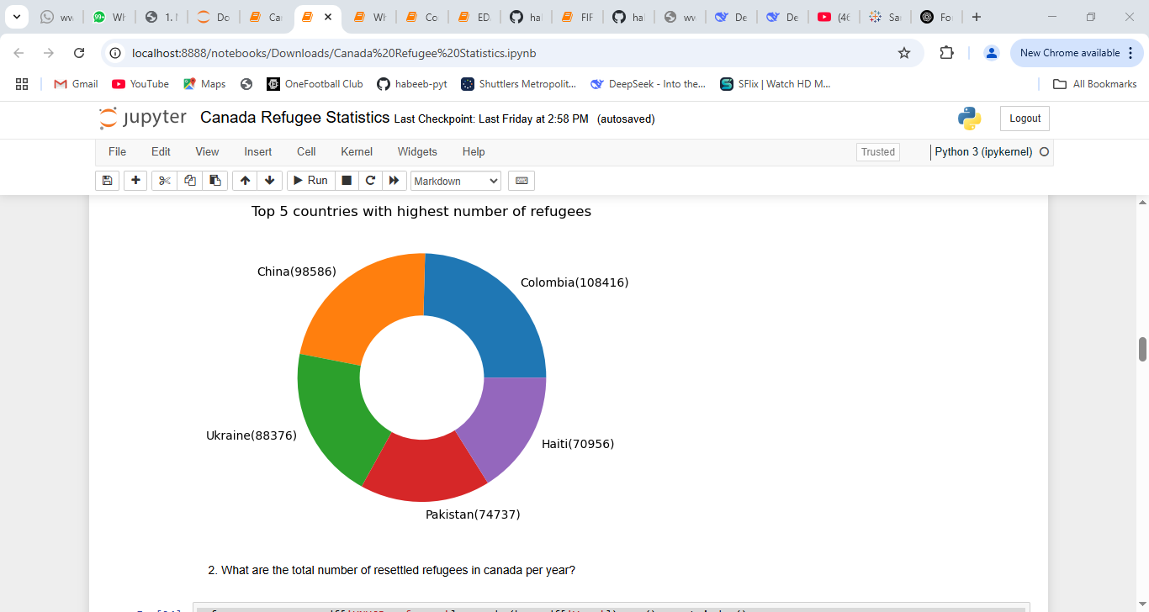
The highest number of refugees came from Colombia with a total of 108,416 People.
Second is China with 98,586 people followed by Ukraine, Haiti and Pakistan respectively.

Slide 5
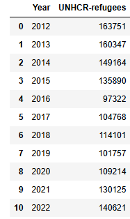
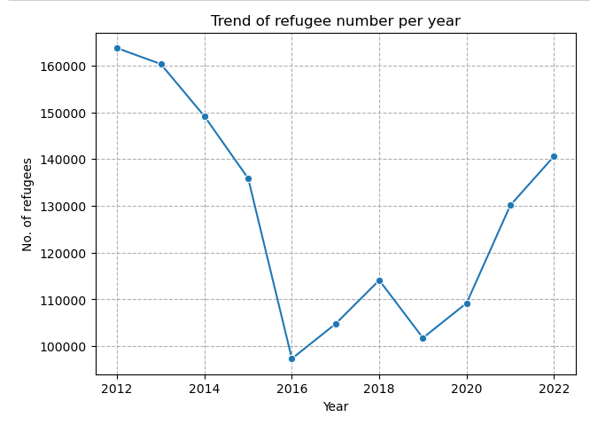
The chart describes a downward trend in the number of refugees accepted in the country from 2012 -2016,at which numbers started to go up until the pandemic hit; After the Pandemic, Another uptrend in the numbers was recorded.

Slide 6
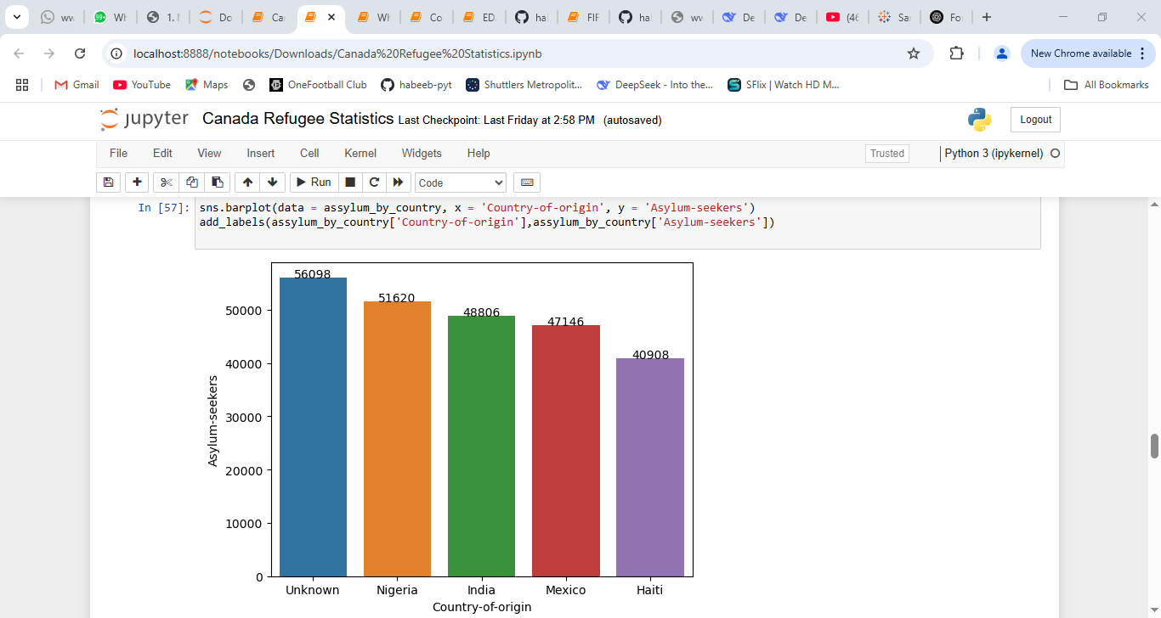
Most Asylum claims were made by people whose country of origin could not be determined.
During the 10 year period, over 50000 asylum claims was made by Nigerians putting the country at first position for claims from known countries.
Next is India, Mexico and Haiti respectively having over 40000 claims each .

Slide 7
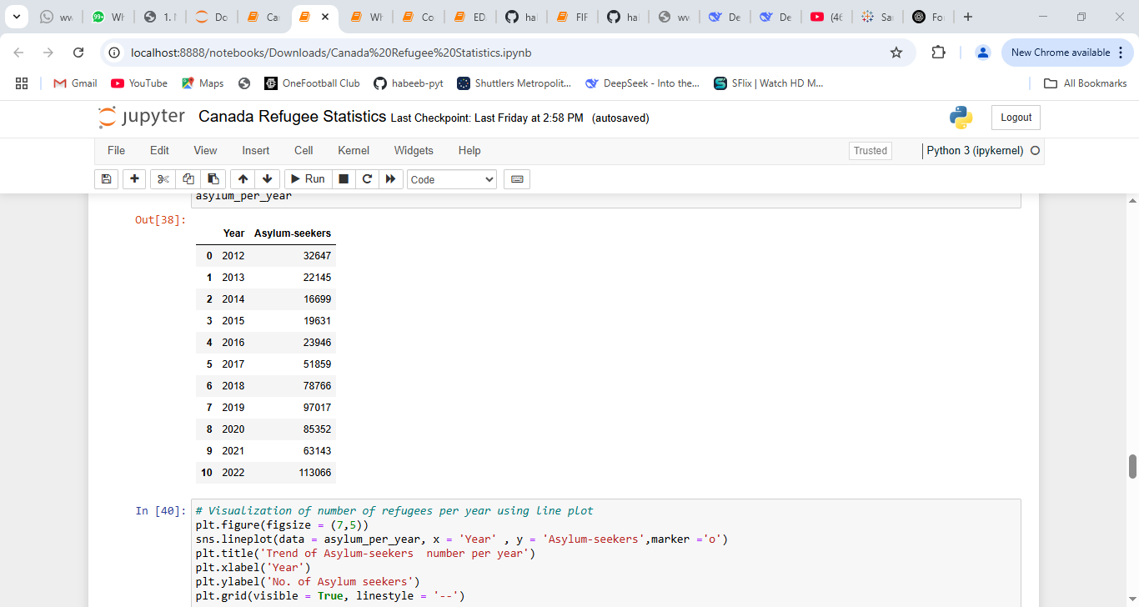
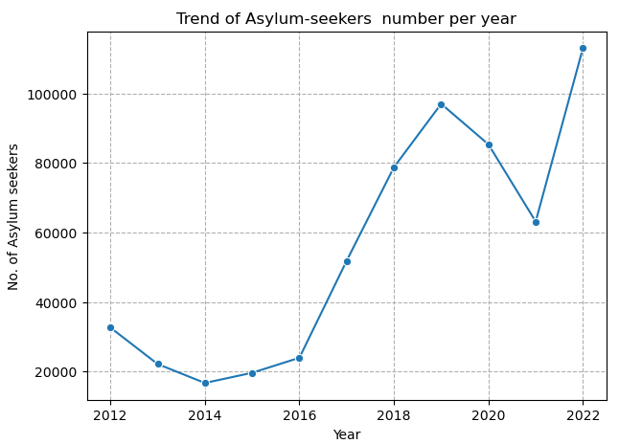
The chart shows a rising trend in the number of asylum seekers over the years with a significant drop from 2020 – 2021 as a result of the Covid-19 pandemic, after which the steady rise in number continued.

Slide 8
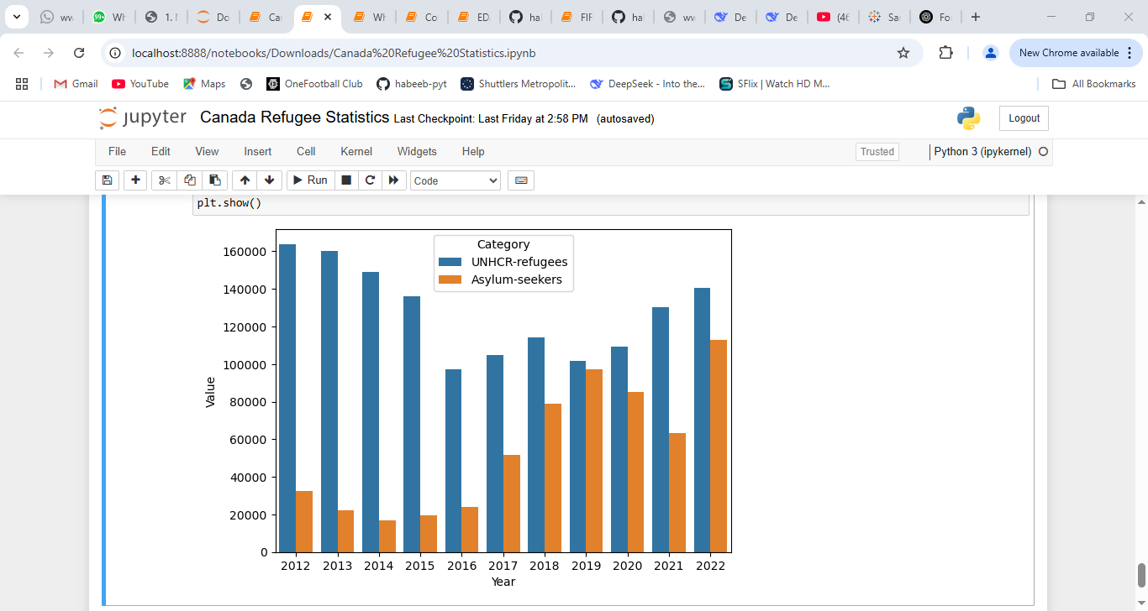
This trend shows that over the year, the number of Asylum seekers increased significantly in relation to the number of confirmed refugees which signals a drop in the level at which Asylum seekers are granted refugee status.

